Slide 1

Z.Jamil, N.Dudhia, L.Redhead-Davis, U.Sajid, P.Sephton

Slide 2

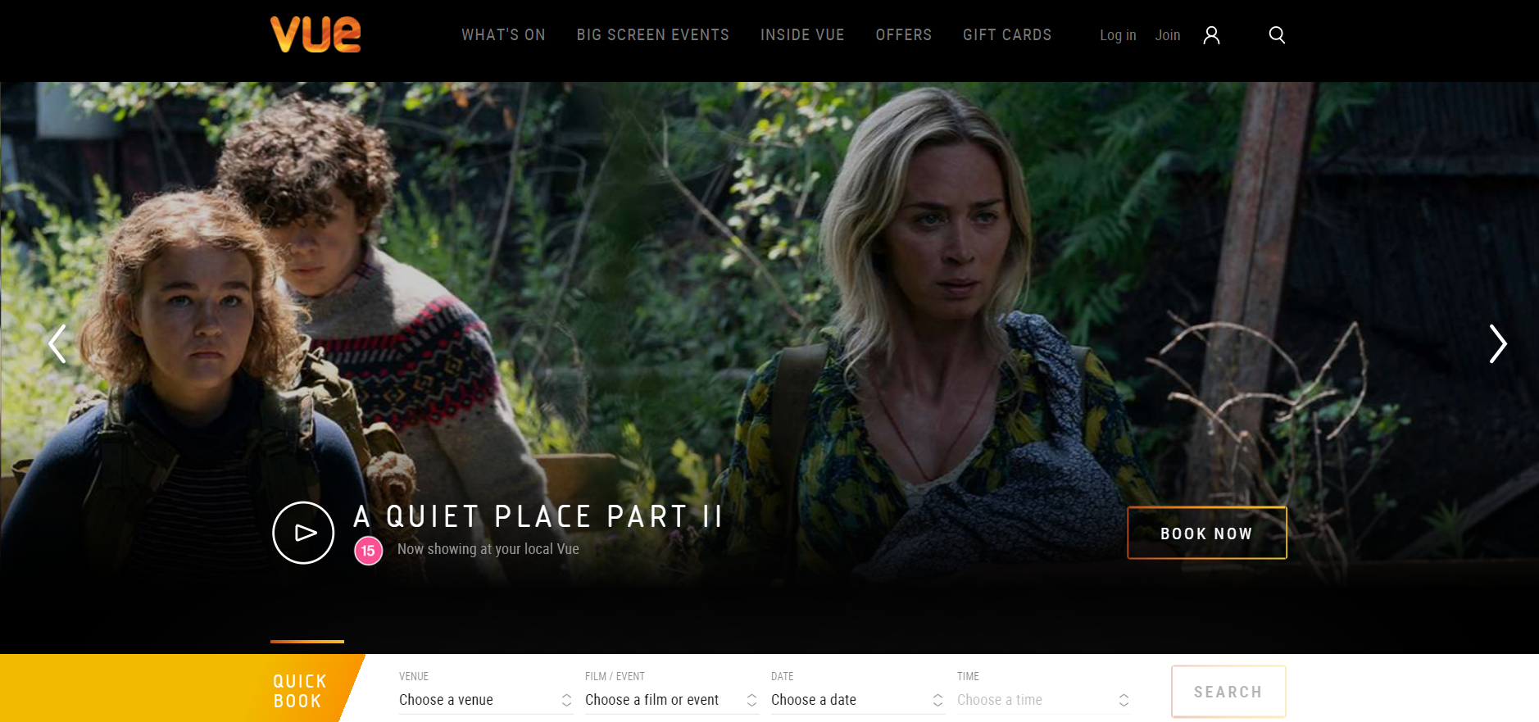
Concept
The concept was to create a functioning cinema web application in which information regarding the cinemas, films and surrounding areas can be viewed. The website also required a need to make orders to view a film at a cinema of the users choosing. The design was aimed to be similar to current well established cinemas.
Notes:
We used ‘big cinemas’ as an idea into the most common features found on these websites and used that as a guide. Some features such as the banner on the homepage and the navbar at the top was consistent with each website and so we also decided to implement features and designs as such.

Slide 3
Approach
Sprint 1
Sprint 2
*Daily Stand-Ups
*Sprint Retrospective
Project Specification Requirements
Documentation
User stories, Epics and Jira
Front End Designs - Base Pages
Back End: Models, Controllers, Routes
Merging F/e and B/e - Refactoring
Testing
Notes:
Decided to get tasks somewhat done at the start such as documentation to help organise the workflow. This helped as during the end of the project time became scarce so extra organisation allowed for features to be completed in the allotted time.

Slide 4
Sprint Plan
The project was split up into two sprints.
The first sprint’s aim was to create a basic implementation of the front end.
The features implemented during this time chosen to have as much of MVP ready from the start.
Once basic functionality was available on the website, the second sprints aim was to integrate the back end with the front end and thus have the user able to create an order.
Notes:
In the first sprint movie list, basic booking features (buttons and links etc), homepage, whats on page, header & footer, banner, about us and contact us i.e all pages that could be designed without a backend running.
The second sprint we basically finished the MVP requirements and integrated f/e and b/e.

Slide 5
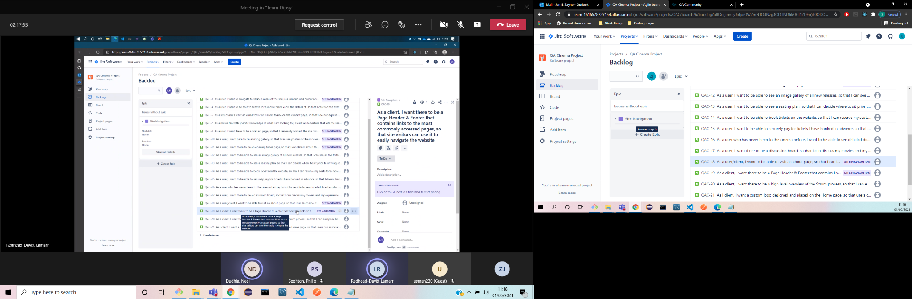
The primary aim for the entire project was to have a deliverable MVP. This meant at times we would have to decide on whether or not to leave features out so we could focus on completing the required checklist.
Notes:
Priority to make the MVP is what drove most decisions during the project. If there was a choice of next steps, whichever option brought us closer to the MVP quicker was the option chosen.
An example of this would be during the start of the second sprint it was decided to complete our booking features before moving onto search functionality since the booking encompassed a larger part of the MVP.

Slide 6
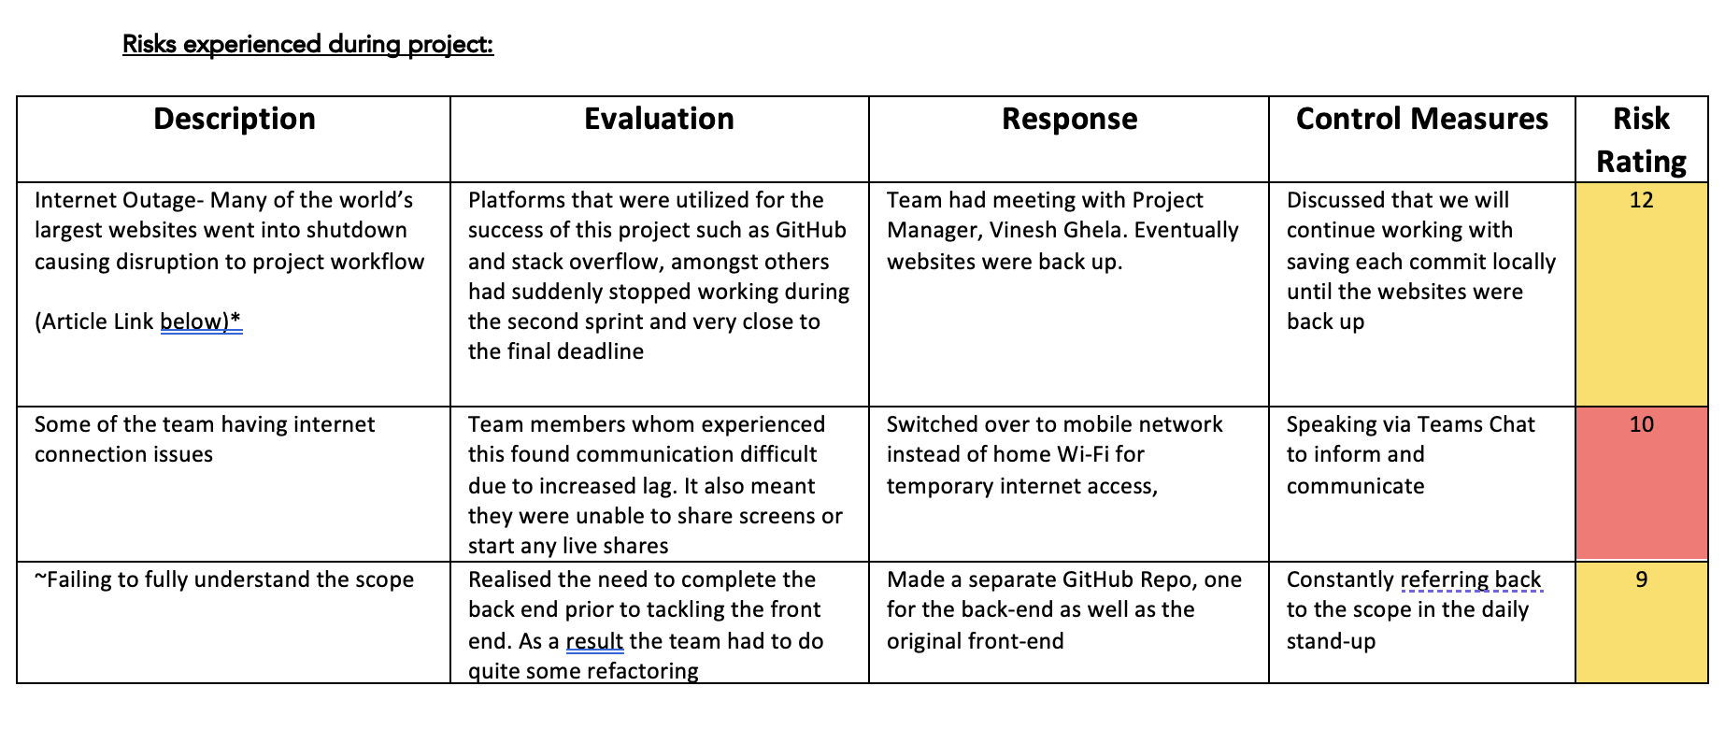
Risk Assessment
Full Risk Assessment available on GitHub
*During the second sprint, an internet issue causing GitHub to go down lead to us working on a single system using VSC’s Live Share plugin. Although some issues were caused by this such as the server dropping during development.
Notes:
Some of the issues raised in the risk assessment occurred as work on the project was being completed. As such we had some idea as to how to rate the risks since we had first hand experience with some of the issues.

Slide 7

Consultant Journey
The stack ~
The technologies ~
Version Control System: Git Source Code Management: GitHub Kanban Board: Jira Full-Stack Development Technologies: MERN stack Database Management System: GCP instance of MySQL/MongoDB o Back-End Programming Language: Node API Development Platform: Express Front-End Development Framework: React Unit Testing: Mocha, Chai
Notes:
This project built on experience and knowledge from previous project to now offer a full stack application - with this time round specific focus on the MERN Stack
We had no prior experience with these frameworks and were able to learn and implement them for this project

Slide 8
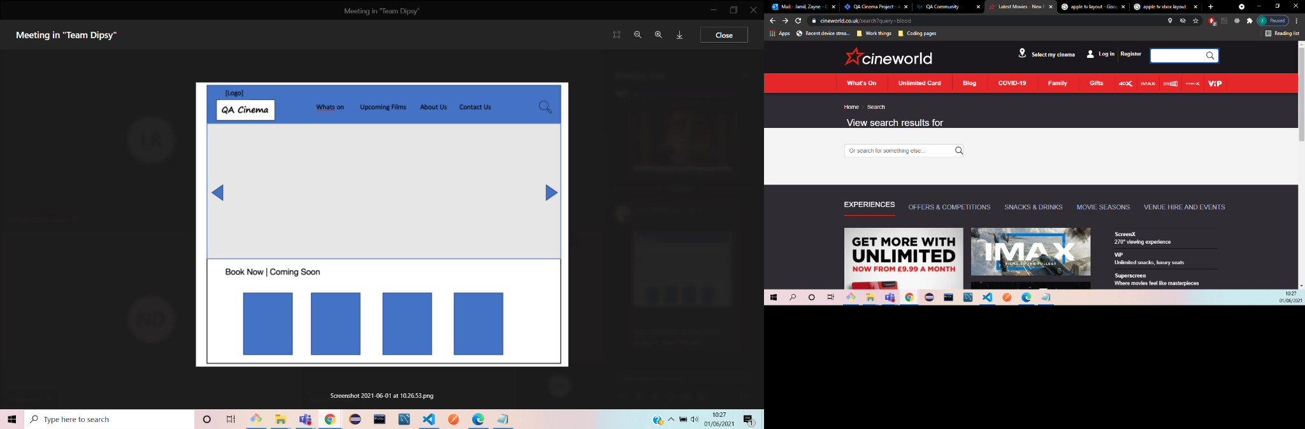
Mock Designs
Mock Designs using Wireframes
Inspiration from popular cinema websites
Provided insight on design, components and visual structure
Notes:
We produced mock designs with influences from popular cinema websites such as cineworld and vue.
These were created through wireframe
Having done this it ave us good idea as to the structure of the website, how the user interface will look but also the actual coding elements with discussions on the components that we weill require to build it out

Slide 9
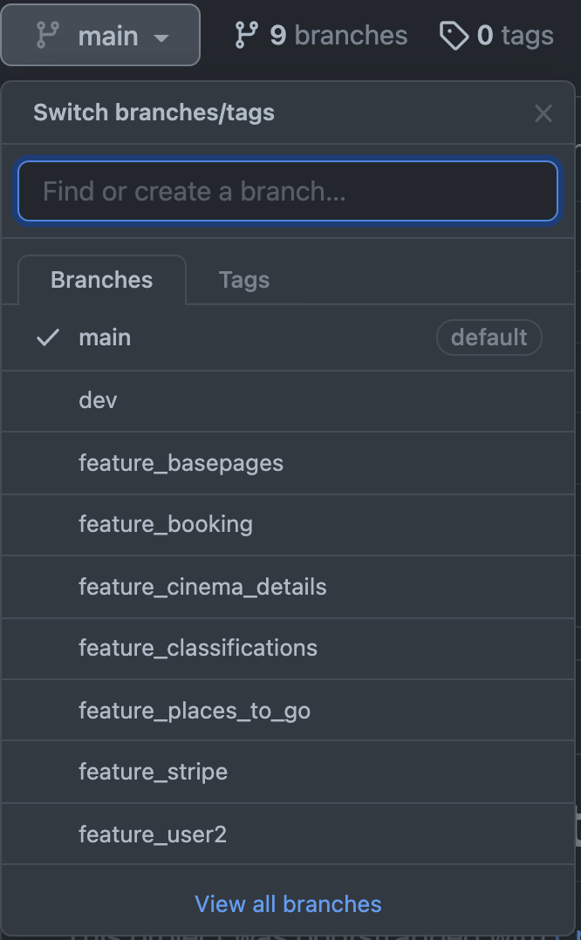
CI
Continuous integration was done with GitHub, a group GitHub was created from which each group member could fork from and work in their own respective repositories.
Several branches for their respected features were created.
In the end, we had a total of 9 branches and over 140 commits
Smart commits were used to add comments onto our Jira issues.
Notes:
A separate repository was created for the front end and the back end.
Work was always pushed to the most relevant Jira issue which allowed everyone in the group to follow what other people had completed and what was yet to be done.

Slide 10
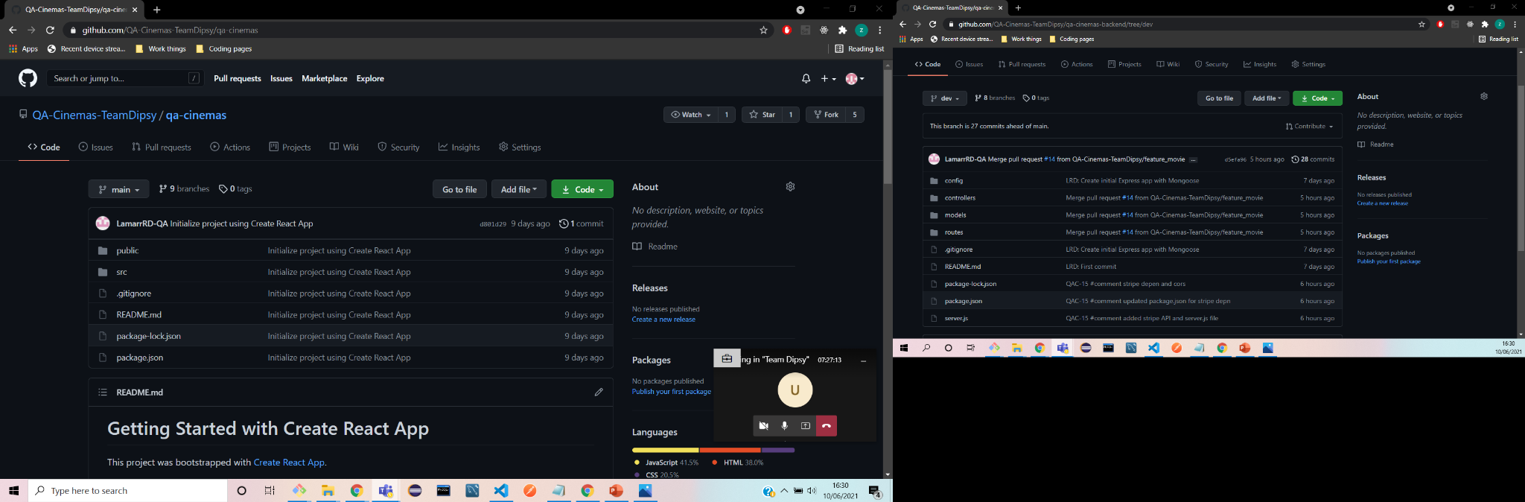

Slide 11

Front end
Front end was made an a React application which makes up part of the MERN stack.
Over 30 components were used to create the front end.
React Bootstrap was implemented as our front end framework.

Slide 12
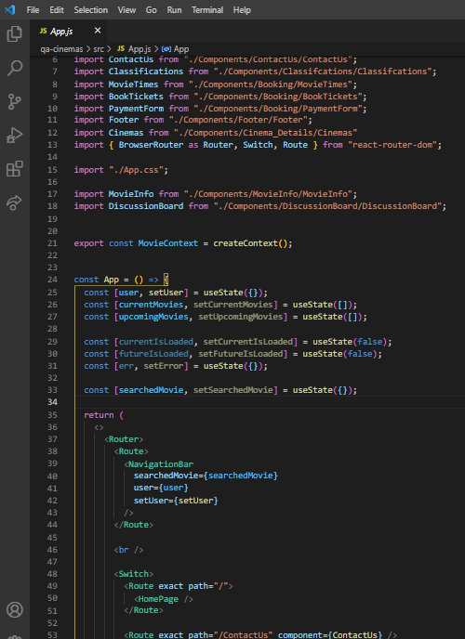
App.js
States were utilised lots during this project to handle rendering on the pages.

Slide 13
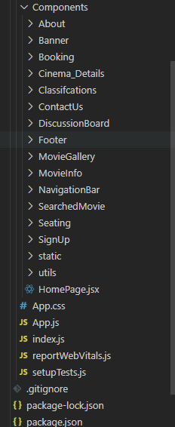
Components
As many components were implemented as possible to increase modularity of the project.

Slide 14
Back end
Created in Express - a minimalist framework used to handle web functionality
Mongoose allowed us to work with a MongoDB database
Notes:
Essentially, the main purpose was to implement middleware in the project.
Mongoose provided a simple API to help work with MOngo databases
No need for database query language e.g SQL
We created a database for : Cinemas, Bookings, Movies and Users

Slide 15
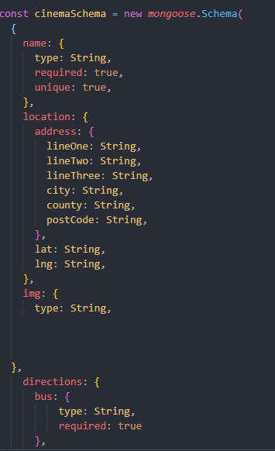
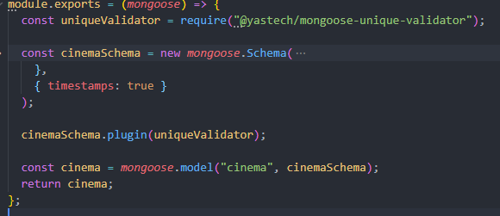
Schema
Notes:
Schema allowed us to define the structure of the collection.
We used a unique validator to ensure no duplicate cinemas could be created

Slide 16
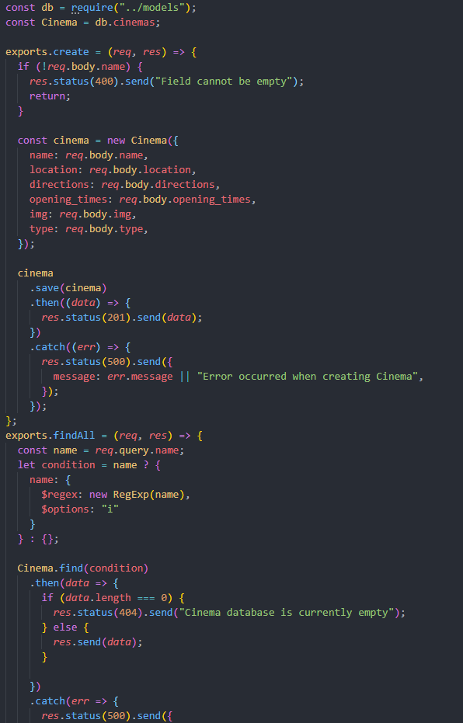
Controller
Notes:
The controller is where the requests were made. The requests were all requested to the router.
Implemented error handling as well

Slide 17
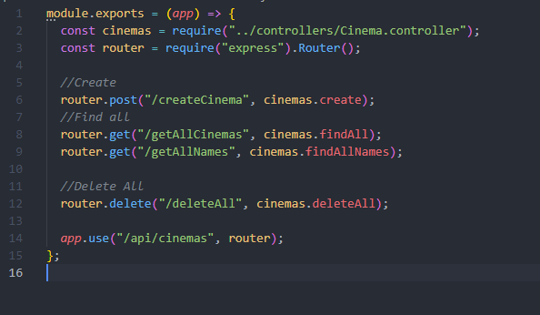
Router

Slide 18
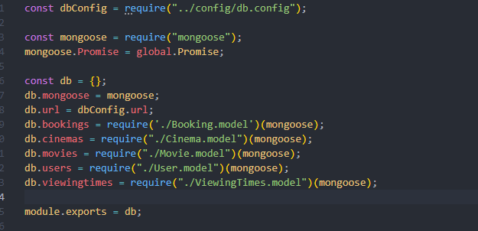
Index

Slide 19
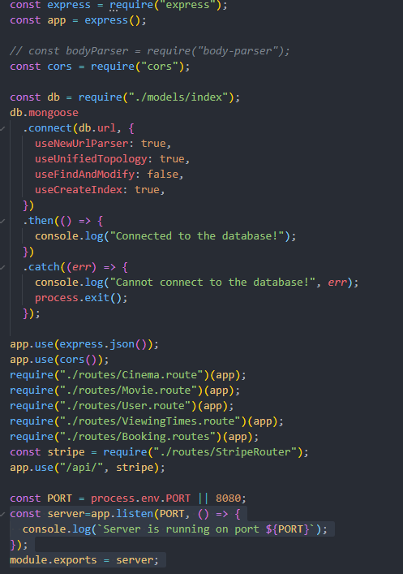
Server.js

Slide 20


Testing
JEST/ Mocha/ Chai
Integration testing and snapshot testing were done with Cha-HTTP and Mocha respectively. More time could have been left for testing however a main priority was to ensure a presentation could be delivered.

Slide 21
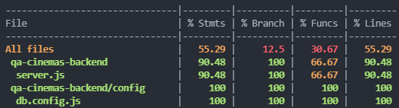
Coverage
Notes:
Total coverage was:

Slide 22
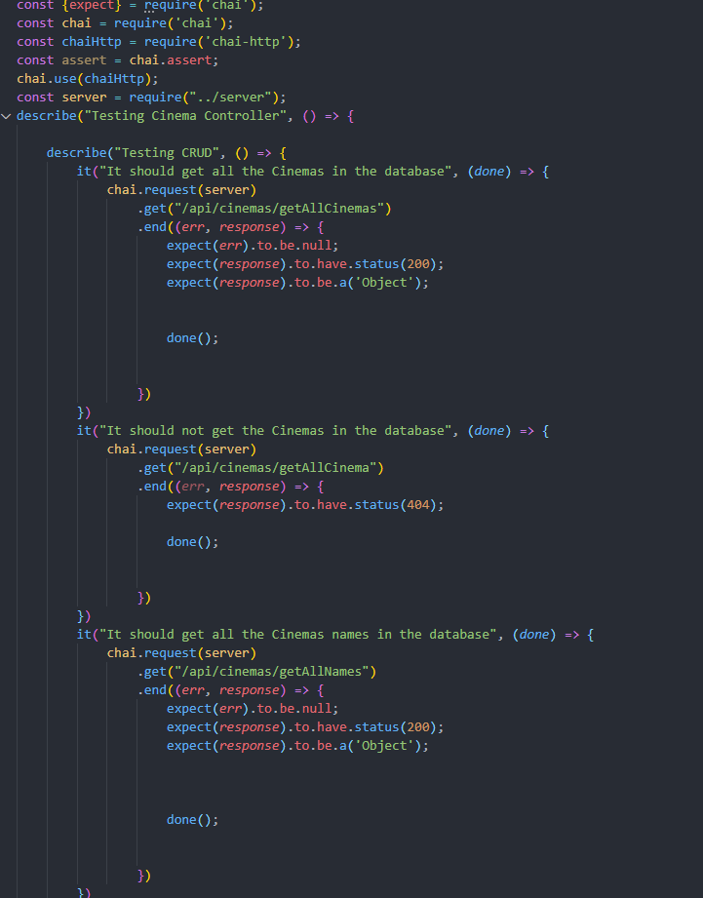
Example test
The following tests CRUD functionality for the cinemas in the database. The test does three things:
It should get all the cinemas in the database (successful case for /getAllCinemas).
It should not get all the cinemas in the database (failed case for /getAllCinemas).
It should get all cinema names in the database. (successful case for /getAllNames).

Slide 23
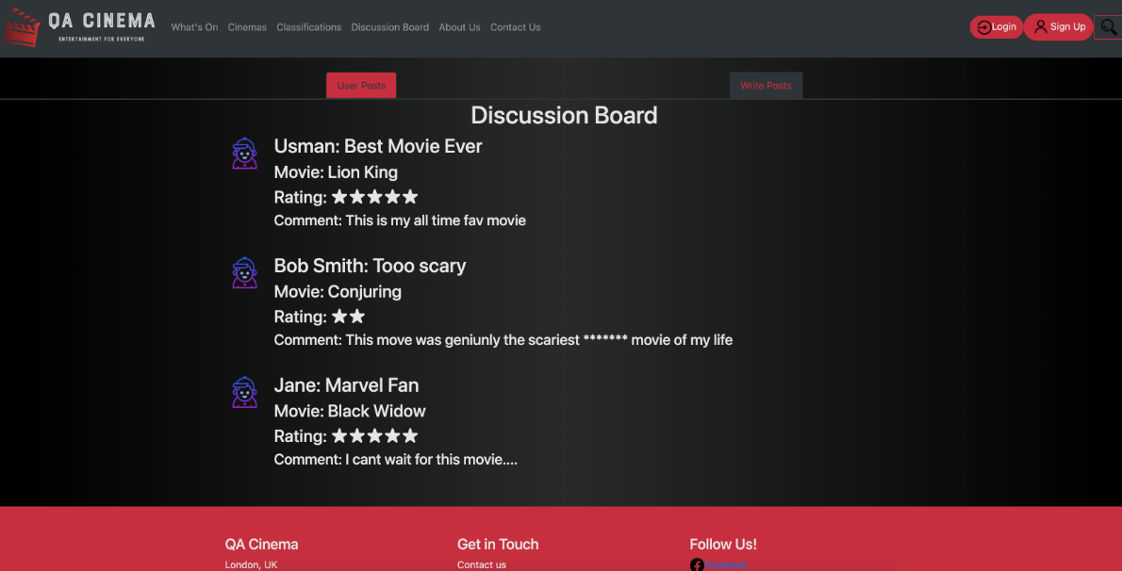
Demo
Demo showing each function and also completing an order.
Notes:
For demo, demonstrate the following:
Feature Movies, Booking:
What’s On > Current Movies > View Info > Select Cinema > Look at Times > Select Time > Select Seats and Tickets > Go to Checkout > Fill fields correctly (card number 4242424242424242)
Visit page and explain:
Cinemas
Classification
About Us
Contact Us > Fill in form
Discussion Board > Write Posts > fill in, Demonstrate Profanity filter, Submit

Slide 24
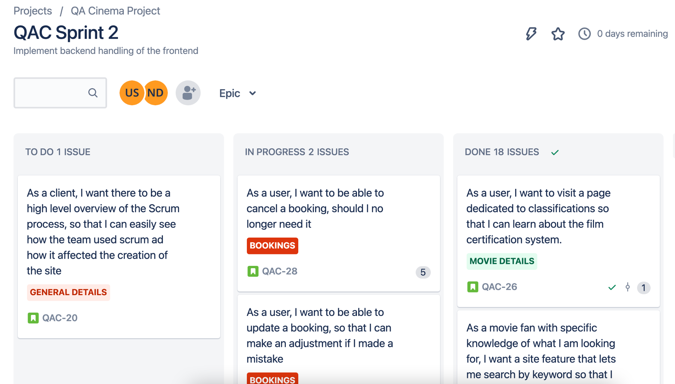
Sprint Review
Most tasks from the fist sprint were completed.
Second sprints had more tasks and issues we came across didn’t fit distinctly into one category. More problems happened since we were integrating front end and back end. So less tasks were completed. However, near all requirements for the MVP were met.
Notes:
Story points and MoSCoW rating was considered for each and as such allowed for a smoother control of workflow.

Slide 25
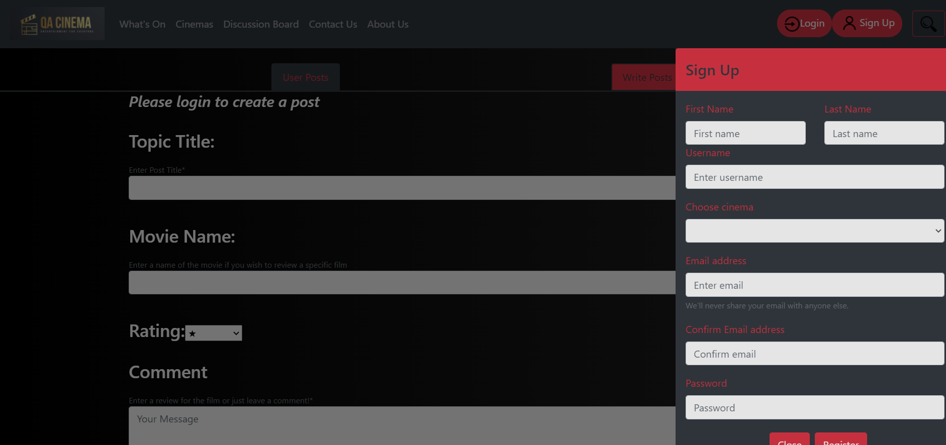
Sprint Retrospective
A simpler approach could have been beneficial since time became a limiting factor at the end of the project.

Slide 26
Conclusion
Throughout the course of the project there was excellent communication.
An agile methodology to handle workflow was implemented.
MoSCoW was implemented to manage which tasks were to be done and in what order.
Team roles were loosely assigned however our approach leaned more towards peer programming since we decided as a group this is how we worked best.
Notes:
MVP was met

Slide 27
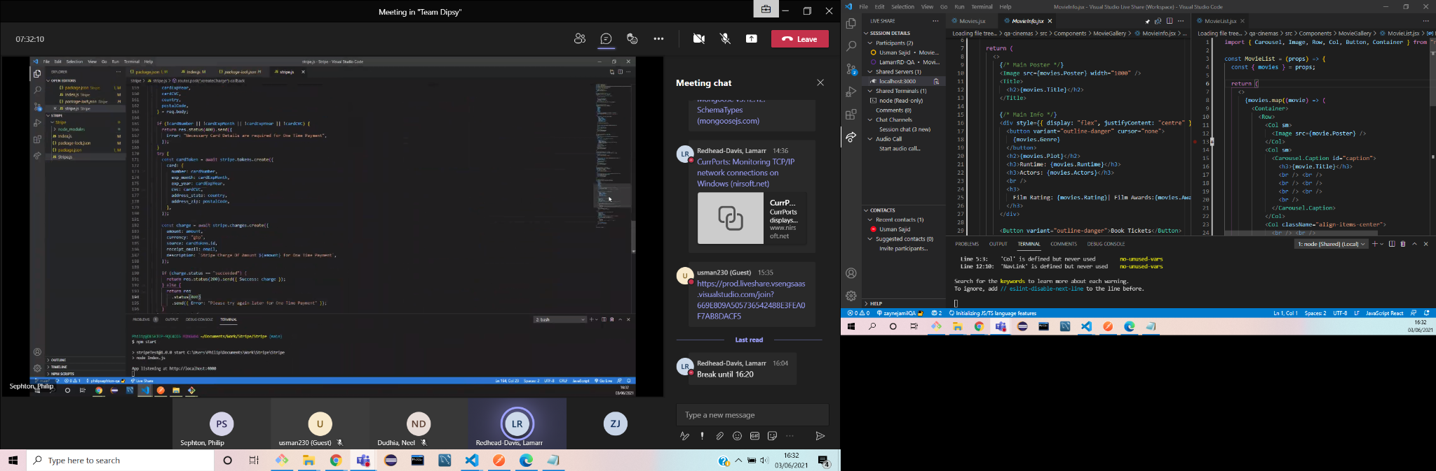

Slide 28

Questions?

